Slide 1
Move, Bauska!
Elizabete Luisa Livina, Kristiana Jaunpetrovica, Roberta Zvejniece, Annija Vitolina, Sofia Ogorodnikova, Dilobar Tojyboyeva, Emils Kragis, Rihards Zilionis

Slide 2

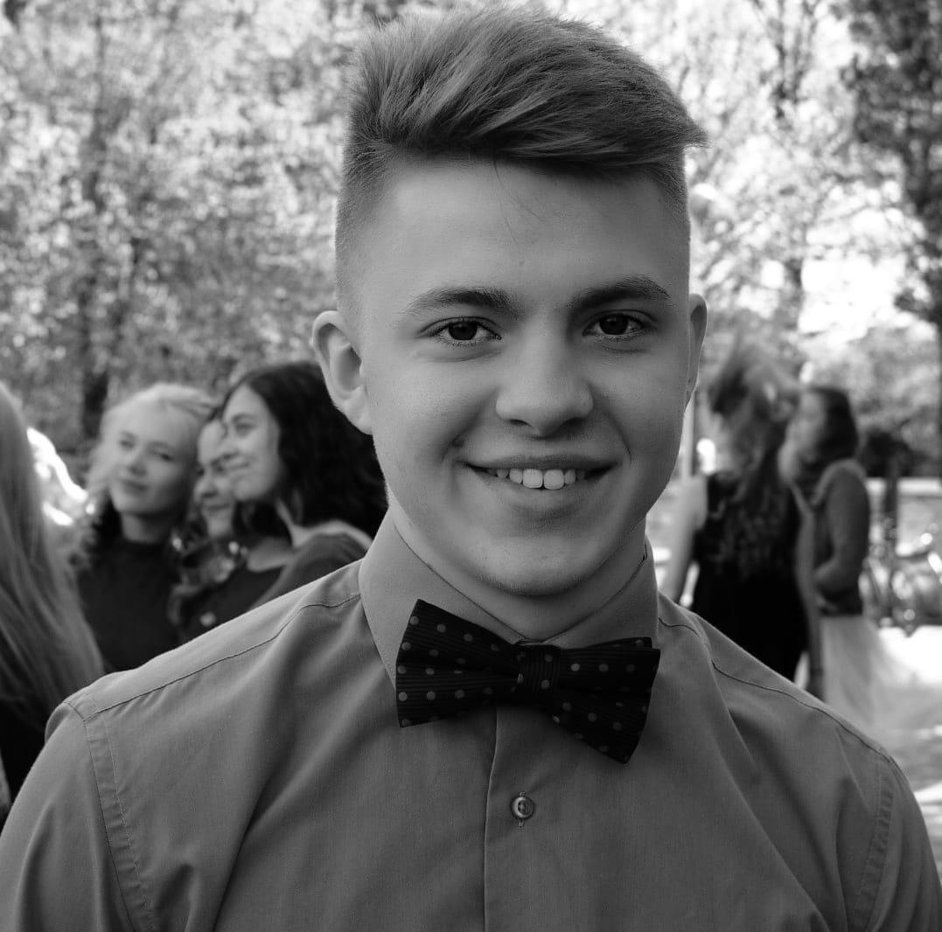
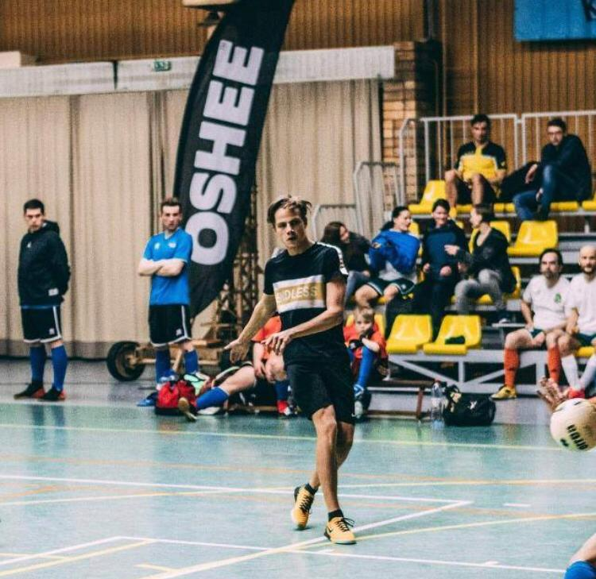

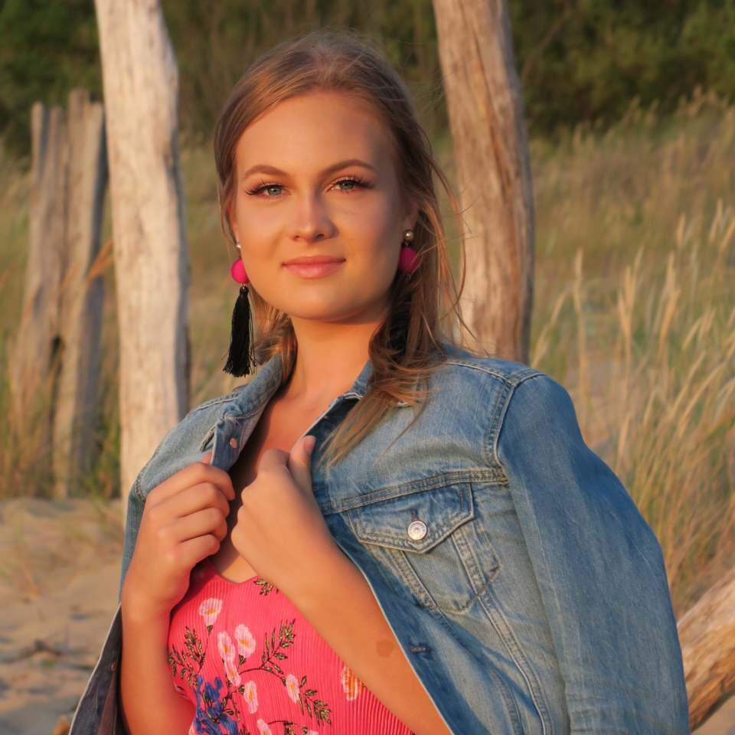
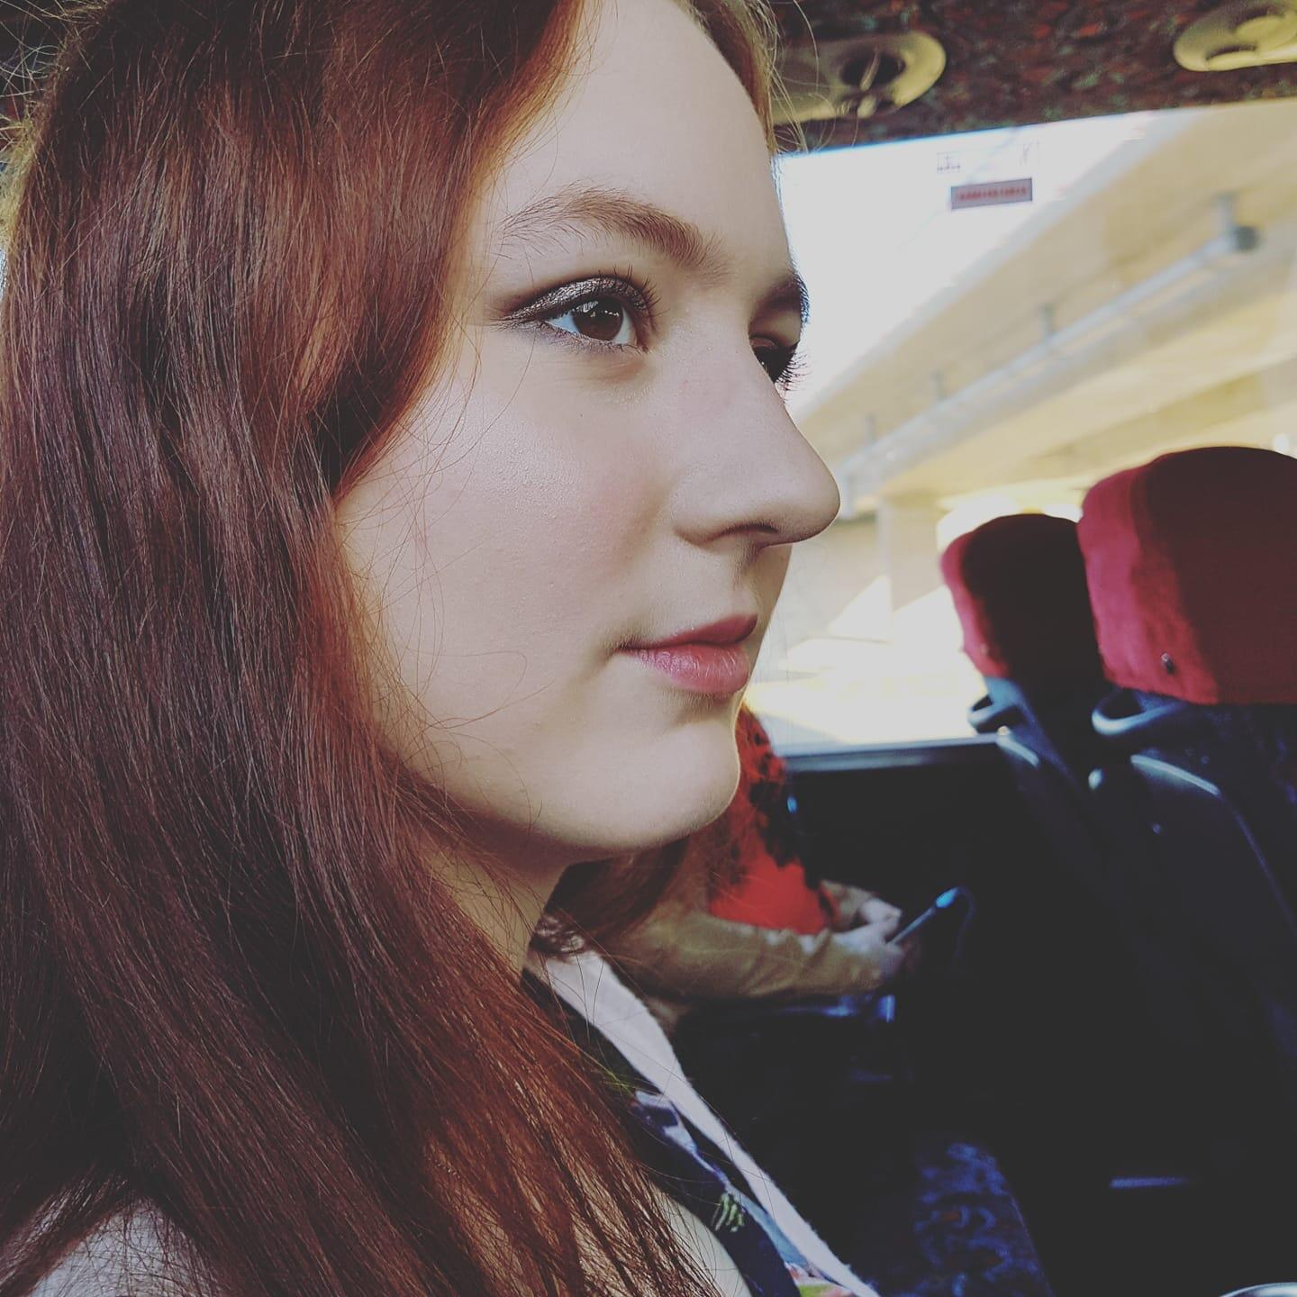
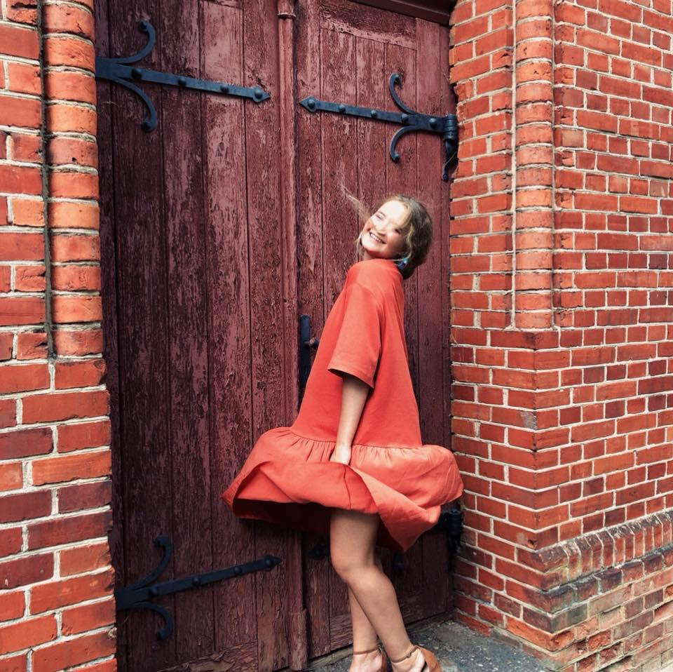
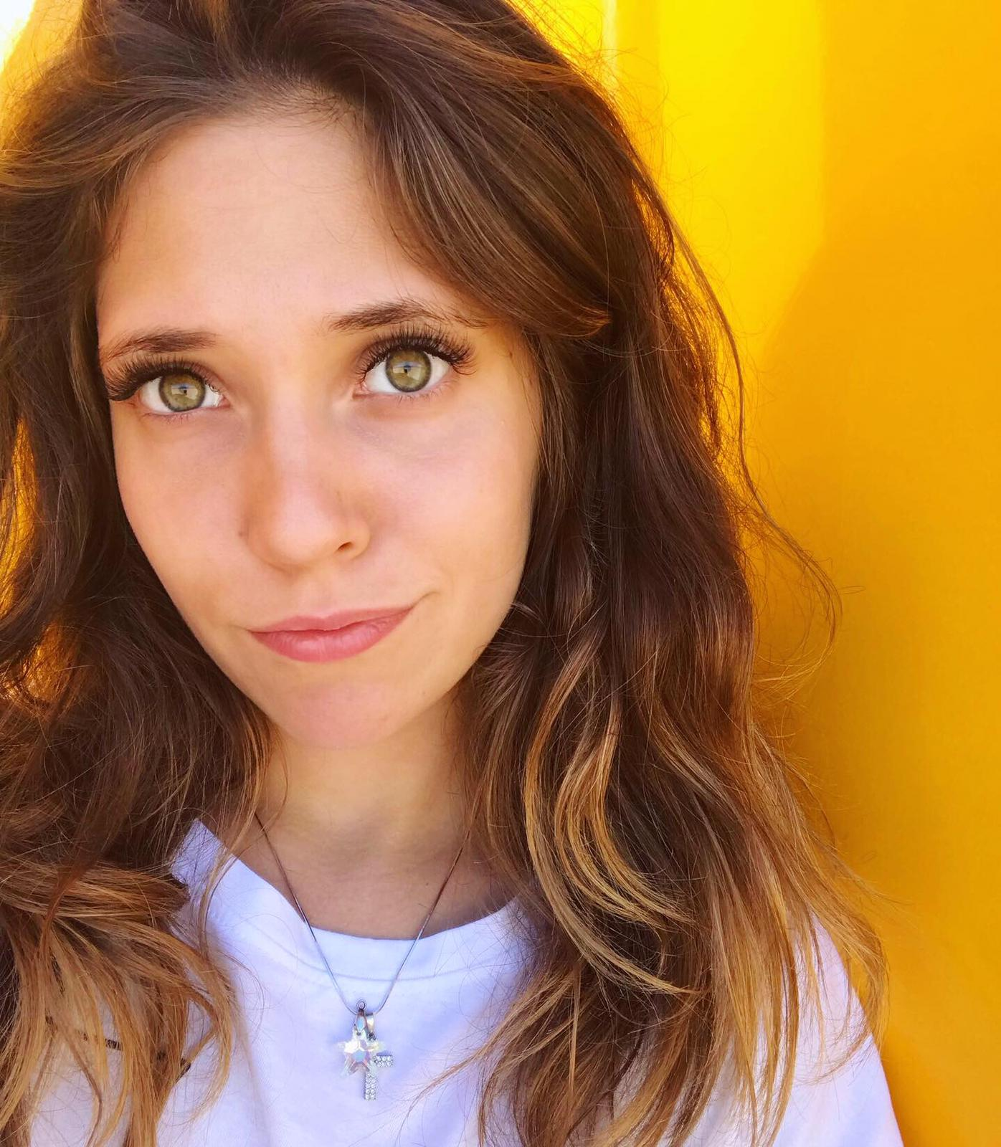
Our Team

Slide 3
Small Introduction
Bauska is located 60 km from Riga
It is situated at the confluence of the shallow rivers Mūsa and Mēmele
The population of the Bauska consist of 9,411 people.

Slide 4
Problems We’re Solving
Lack of tourism Lack of active community

Slide 5
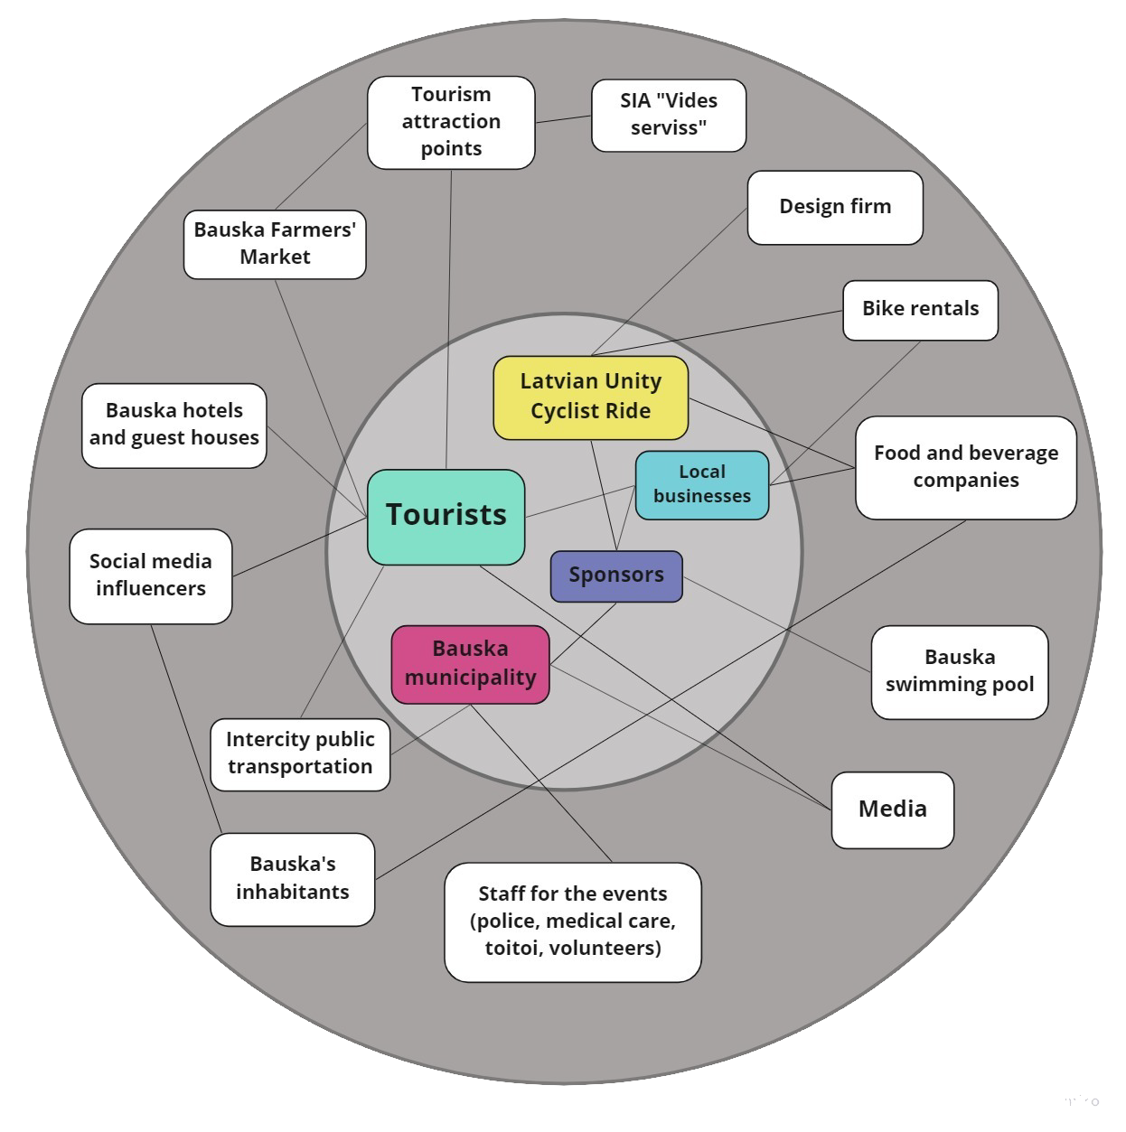
Stakeholders
map

Slide 6
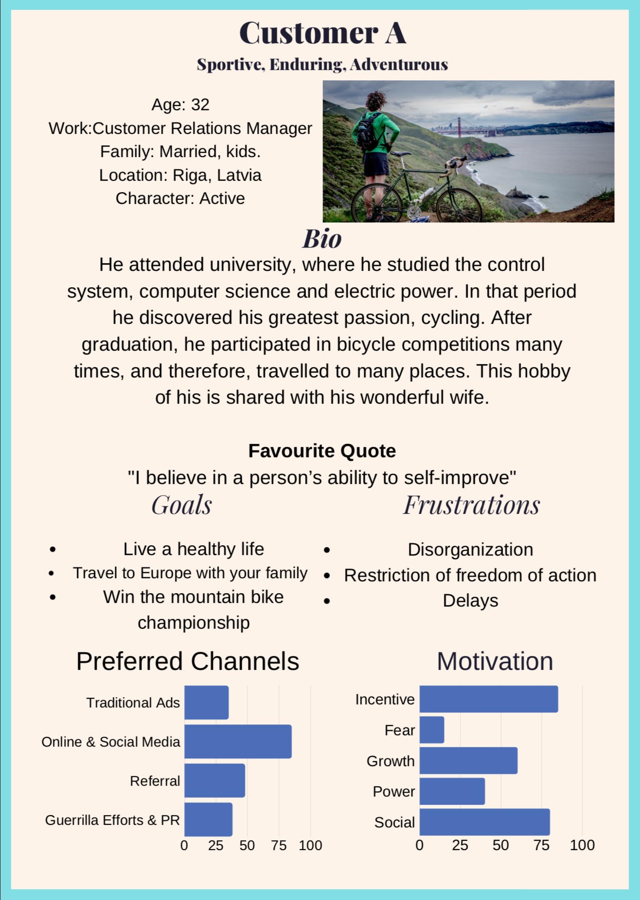

Stakeholders’ Personas

Slide 7
Conclusion
After a conducted research on Bauskas tourism we have concluded, that Bauska has everything for a great tourism - starting from the tourism attraction points and ending with some sports adventures.
Cycling/Walking route with digitalisation
Bauskas cycling unity ride.

Slide 8
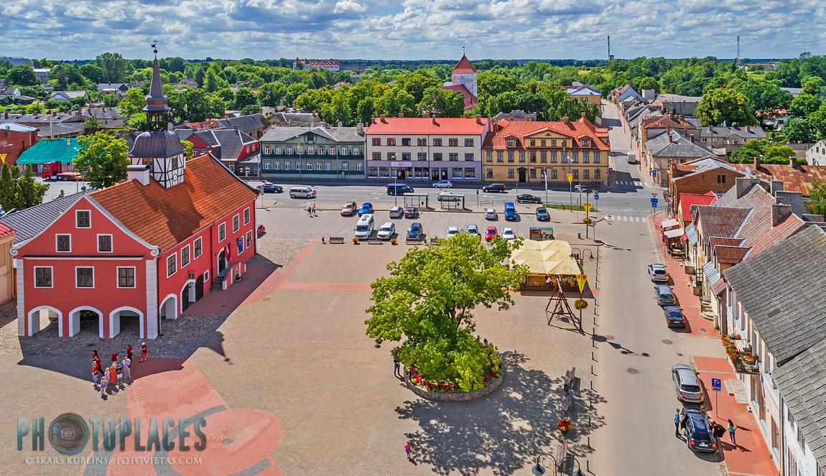
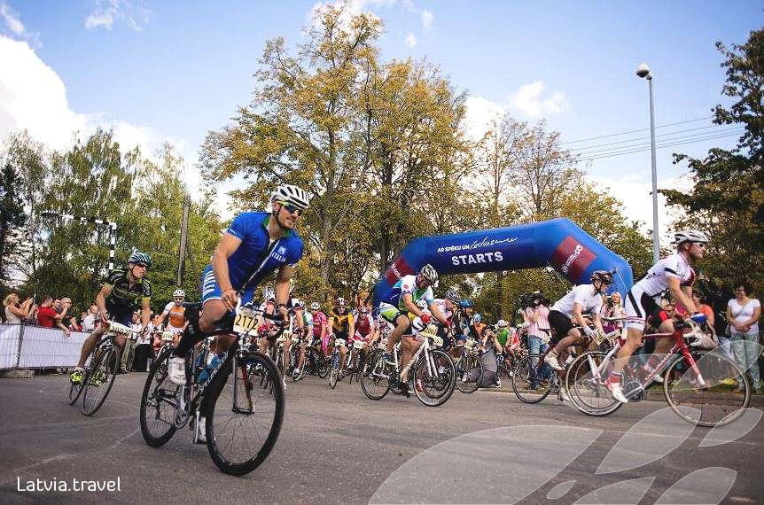
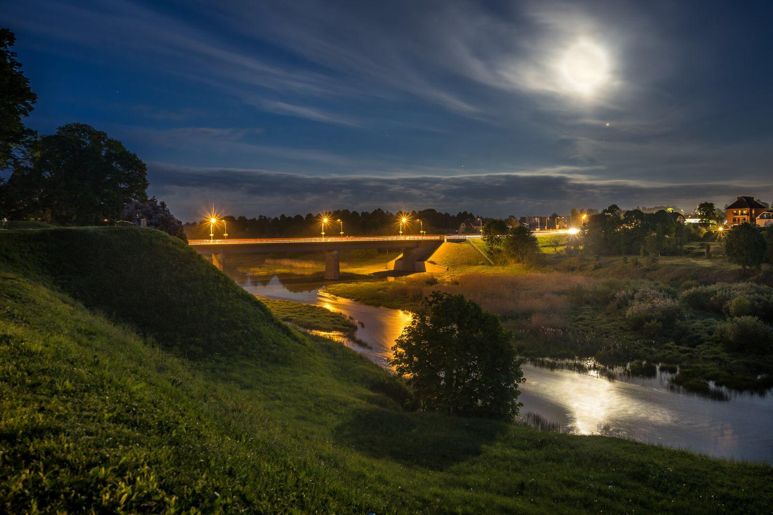
Bauska

Slide 9
Bauska, Move!
Questions & Answers
livinadesigne@gmail.com , kristiana.jaunpetrovica@gmail.com , zvejniece.roberta@gmail.com , vitolinaannija@gmail.com , sonja.croft@gmail.com , tojiboyevadilobar@gmail.com , emilsss25@gmail.com , rihards.zilionis@gmail.com
Thank you!

